Slide 1



MOTION & POSITION TRACKING SYSTEM USING MPU6050
TEAM MEMBERS:
ALDRICH MARIAN A
BARATH M
ASISH C
AKASH SAI

Slide 2
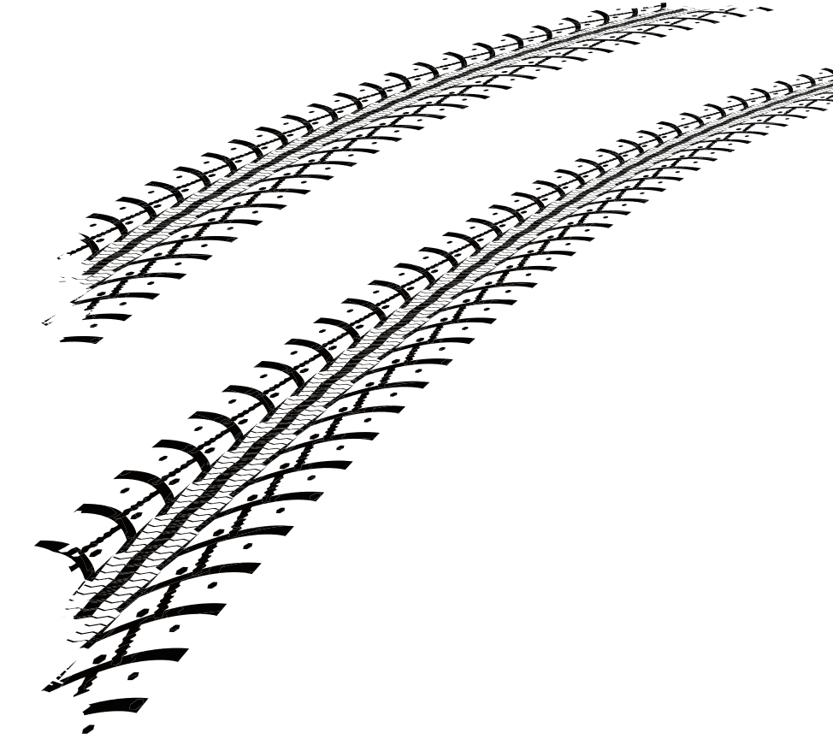
INTRODUCTION
Motion and position tracking plays an important role in monitoring the orientation and movement of objects in real-time. It is widely used in safety systems, automation, sports analysis, and vehicle stability control. The main objective is to detect unsafe motion patterns early and provide alerts or preventive actions to avoid accidents.

Slide 3
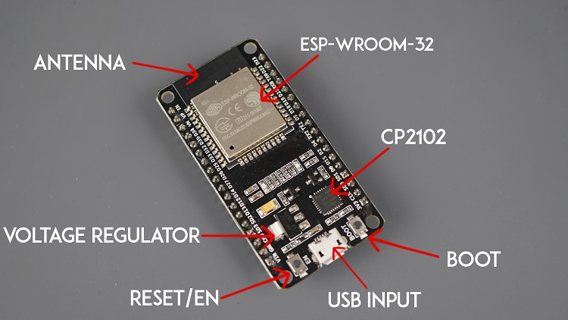
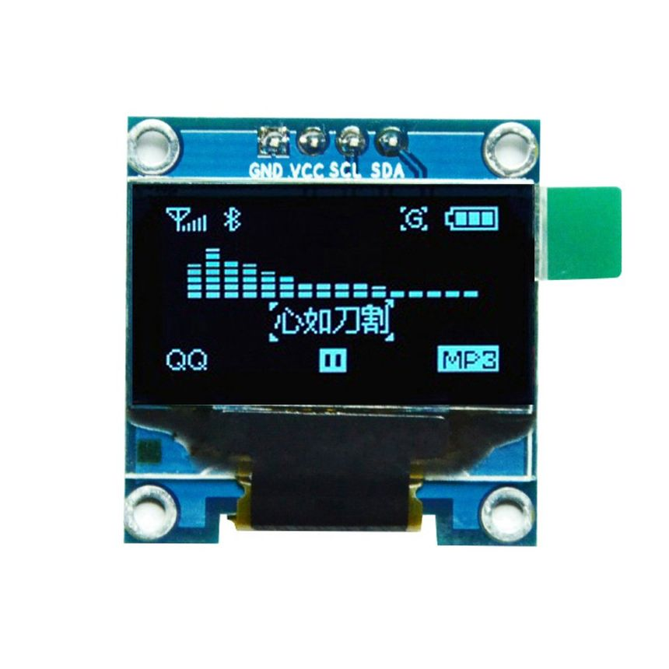

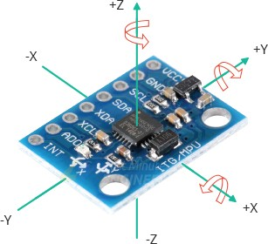
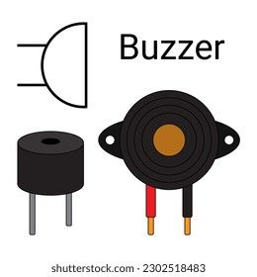
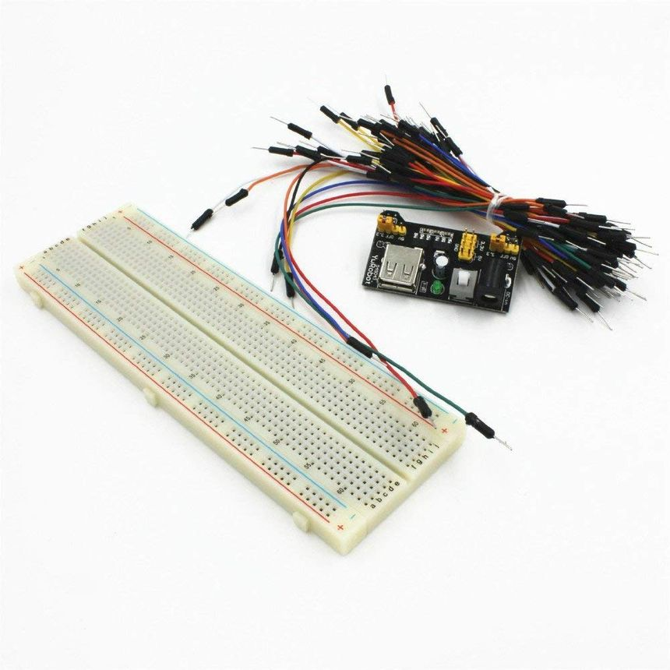
COMPONENTS REQUIRED
OLED Display
ESP32 microcontroller
MPU6050 (Accelerometer+Gyroscope)
Buzzer for Audible Alerts
Breadboard & Jumper wires

Slide 4
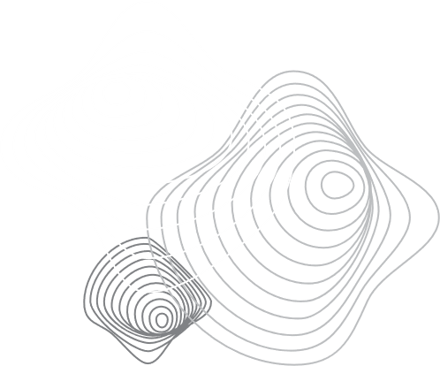
WORKING PRINCIPLE
The accelerometer measures acceleration along the X, Y, and Z axes. It works on the principle of a tiny proof mass inside the sensor: when acceleration occurs, this mass deflects, changing the capacitance, which is converted into acceleration values.
The gyroscope measures angular velocity, or how fast the sensor is rotating around each axis. It uses the Coriolis effect—when the device rotates, vibrating structures inside experience a small force, which is translated into rotational speed.
Together, these values allow the MPU6050 to detect orientation, tilt, motion, and rotation in real time. The sensor communicates this data digitally through the I²C interface, making it easy to integrate with microcontrollers like Arduino or ESP32.

Slide 5
WORKING PRINCIPLE
The ESP32 is a powerful microcontroller with built-in Wi-Fi and Bluetooth capabilities, widely used in IoT and smart device applications .
It has multiple built-in modules like ADC, DAC, PWM, I²C, SPI, UART, and capacitive touch sensors, allowing it to directly interface with a wide range of sensors and devices.
The working principle revolves around combining computation + wireless communication. It processes input data from sensors, executes programmed instructions, and then can send or receive data over Wi-Fi or Bluetooth without needing an extra module.
It operates on 3.3V logic, and its firmware is programmable using platforms like Arduino IDE, MicroPython, or ESP-IDF.

Slide 6
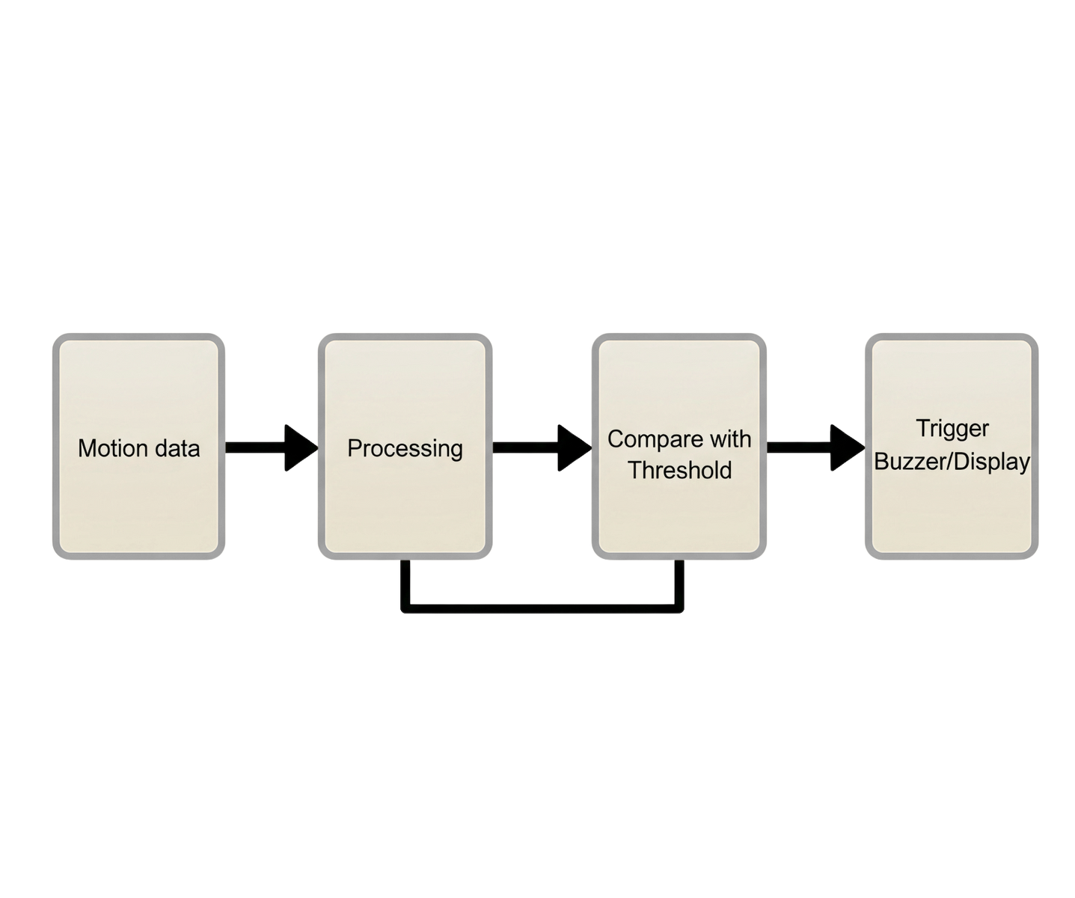
FLOWCHART

Slide 7
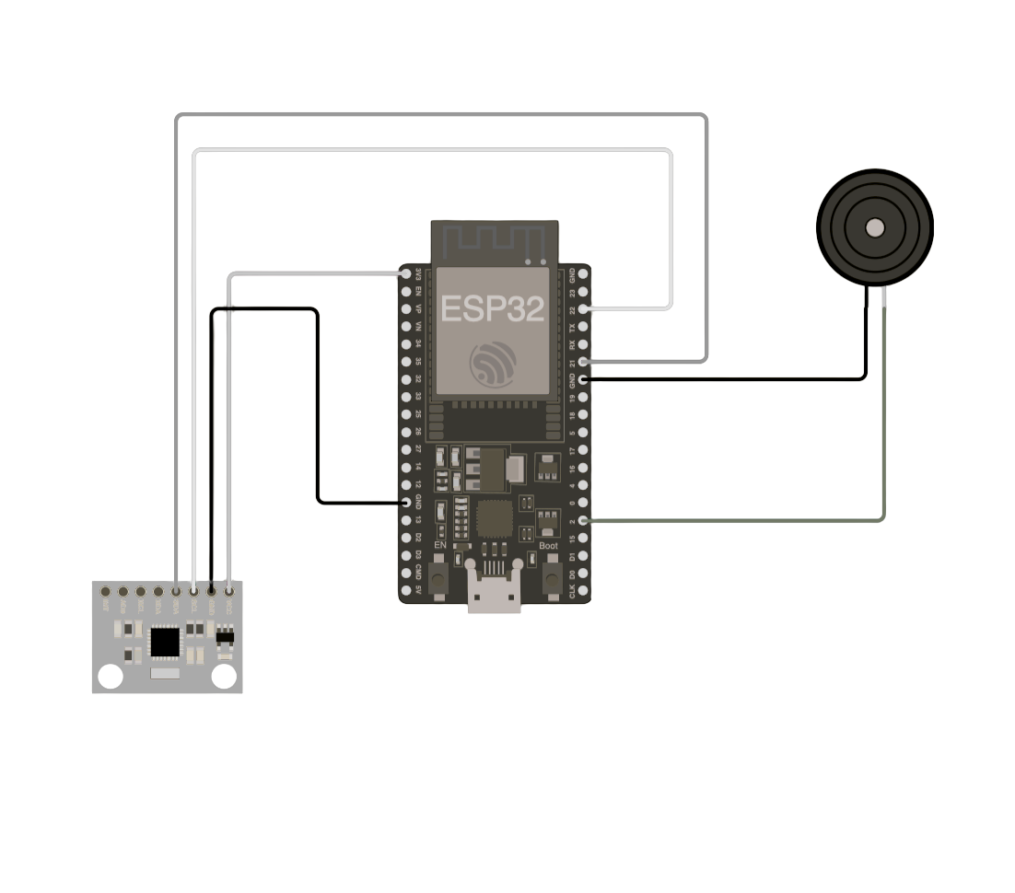
CIRCUIT CONNECTION:
Diagram of ESP32 ↔ MPU6050 ↔ OLED ↔ Buzzer
Mention pin connections (SDA, SCL, VCC, GND, GPIO pins)
OUTPUT:
OLED displaying acceleration values
Buzzer beeping when tilt angle > threshold

Slide 8

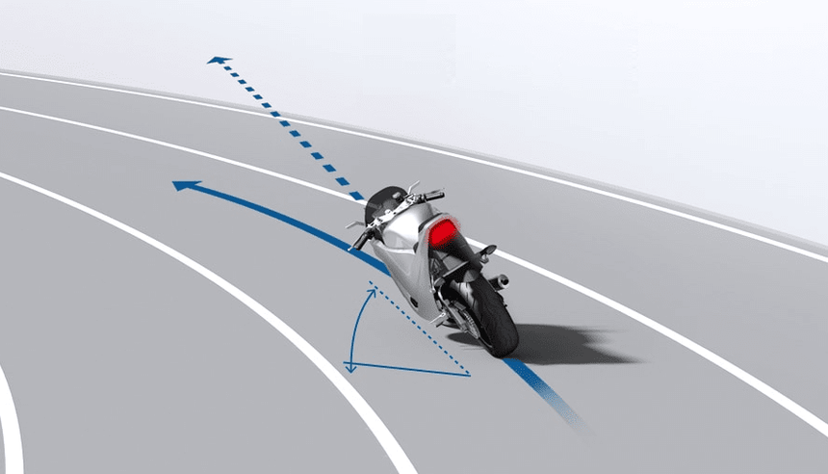
APPLICATION IN BIKE CORNERING (EXTENSION IDEA):
Rider corners bike → MPU6050 detects lean angle
If lean angle > safe limit (e.g., 45°), buzzer beeps
If rider is about to fall (sudden angular acceleration + loss of balance detected), airbag system in rider’s jacket deploys
Prevents accidents by early warning + injury reduction

Slide 9

REAL-WORLD IMPACT:
Accident prevention in sharp turns
Real-time warning system for riders
Airbag technology for enhanced safety
Can be extended to cars, Airbag technology , sports

Slide 10
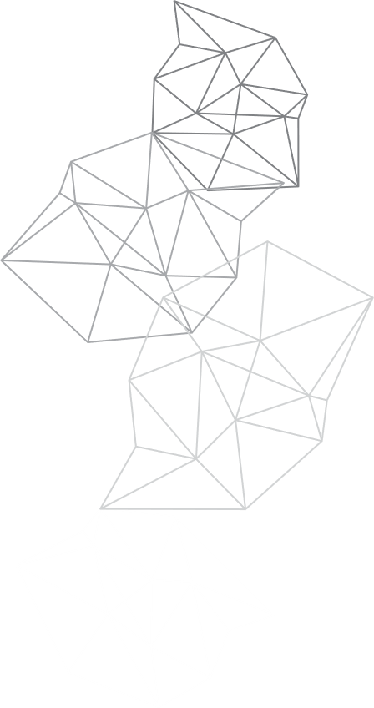
CONCLUSION
MPU6050 with ESP32 can track motion & orientation effectively
Useful in safety systems (bike, automotive, industrial)
Future Scope: integrate with IoT, AI-based crash prediction

Slide 11

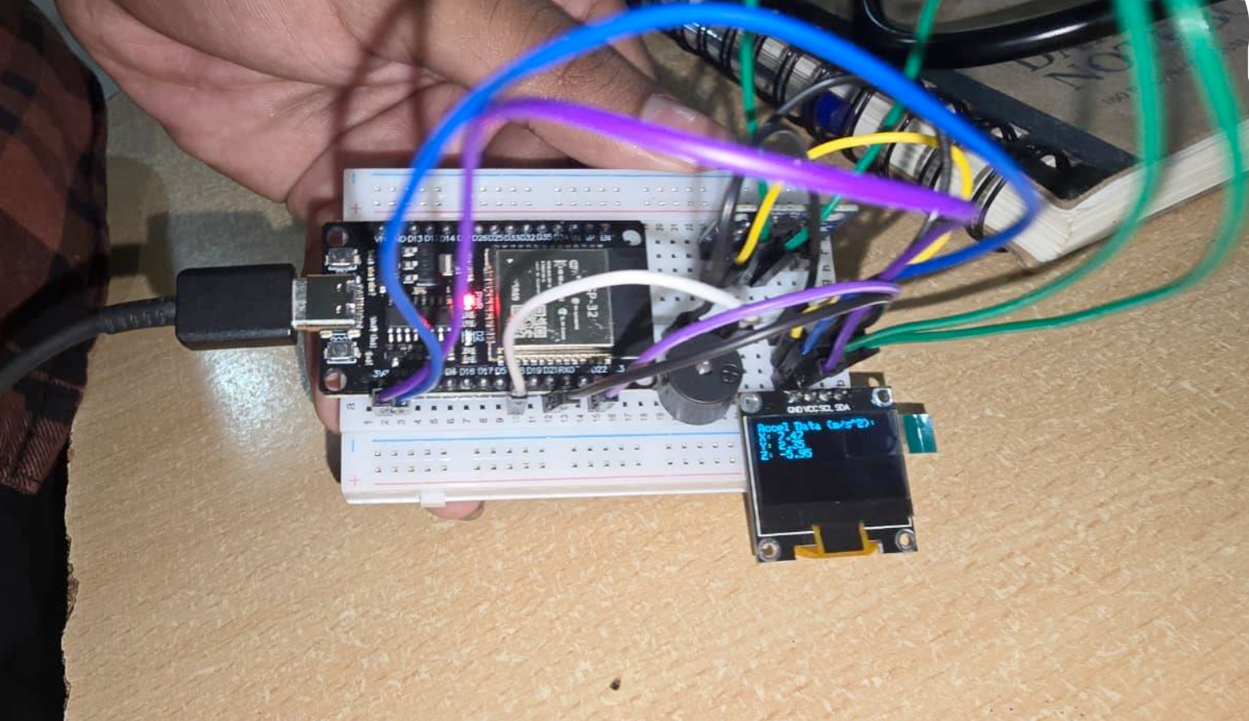
EXECUTION:

Slide 12
THANK YOU

